Slide 1
WELCOME TO PROGRAM OF STUDIES NIGHT
FEBRUARY 27, 2018

Slide 2
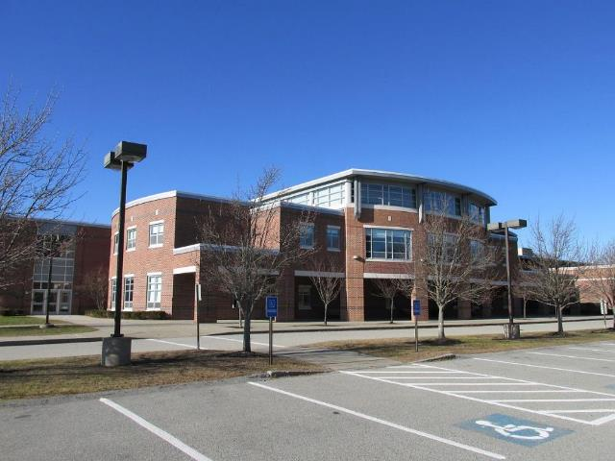
A “TOP TEN” LIST: THINGS TO KNOW ABOUT COURSE SELECTION

Slide 3
10. THE PROGRAM OF STUDIES IS NOW AVAILABLE ON THE HHS WEBSITE

Slide 4
9. THE WHOLE THING ALIGNS WITH OUR MISSION…

Slide 5
…OUR CORE VALUES…
FULFILLMENT OF INDIVIDUAL POTENTIAL
RESPECT FOR SELF AND OTHERS
CIVIC RESPONSIBILITY
COMMITMENT TO LIFE-LONG LEARNING
ENVIRONMENTAL STEWARDSHIP
GLOBAL CITIZENSHIP

Slide 6
…AND OUR EXPECTATIONS FOR STUDENT LEARNING
ALL HHS GRADUATES WILL:
READ PURPOSEFULLY
WRITE EFFECTIVELY
COMMUNICATE EFFECTIVELY
IDENTIFY, ANALYZE AND SOLVE PROBLEMS
DEMONSTRATE SELF-RESPECT AND RESPECT FOR OTHERS

Slide 7
8. COUNSELORS VISIT ENGLISH CLASSES SOON TO EXPLAIN THE POS & COURSE SELECTION PROCESS (2/27&2/28 @ HHS; 3/7 @ HMS – Assembly)
NOVEMBER 16-18

Slide 8
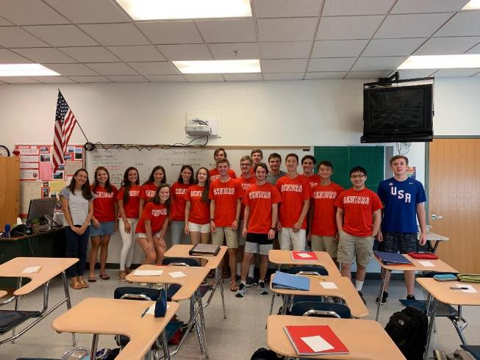
7. STUDENTS & PARENTS MAKE COURSE SELECTIONS ONLINE: 3/11 - 3/19

Slide 9
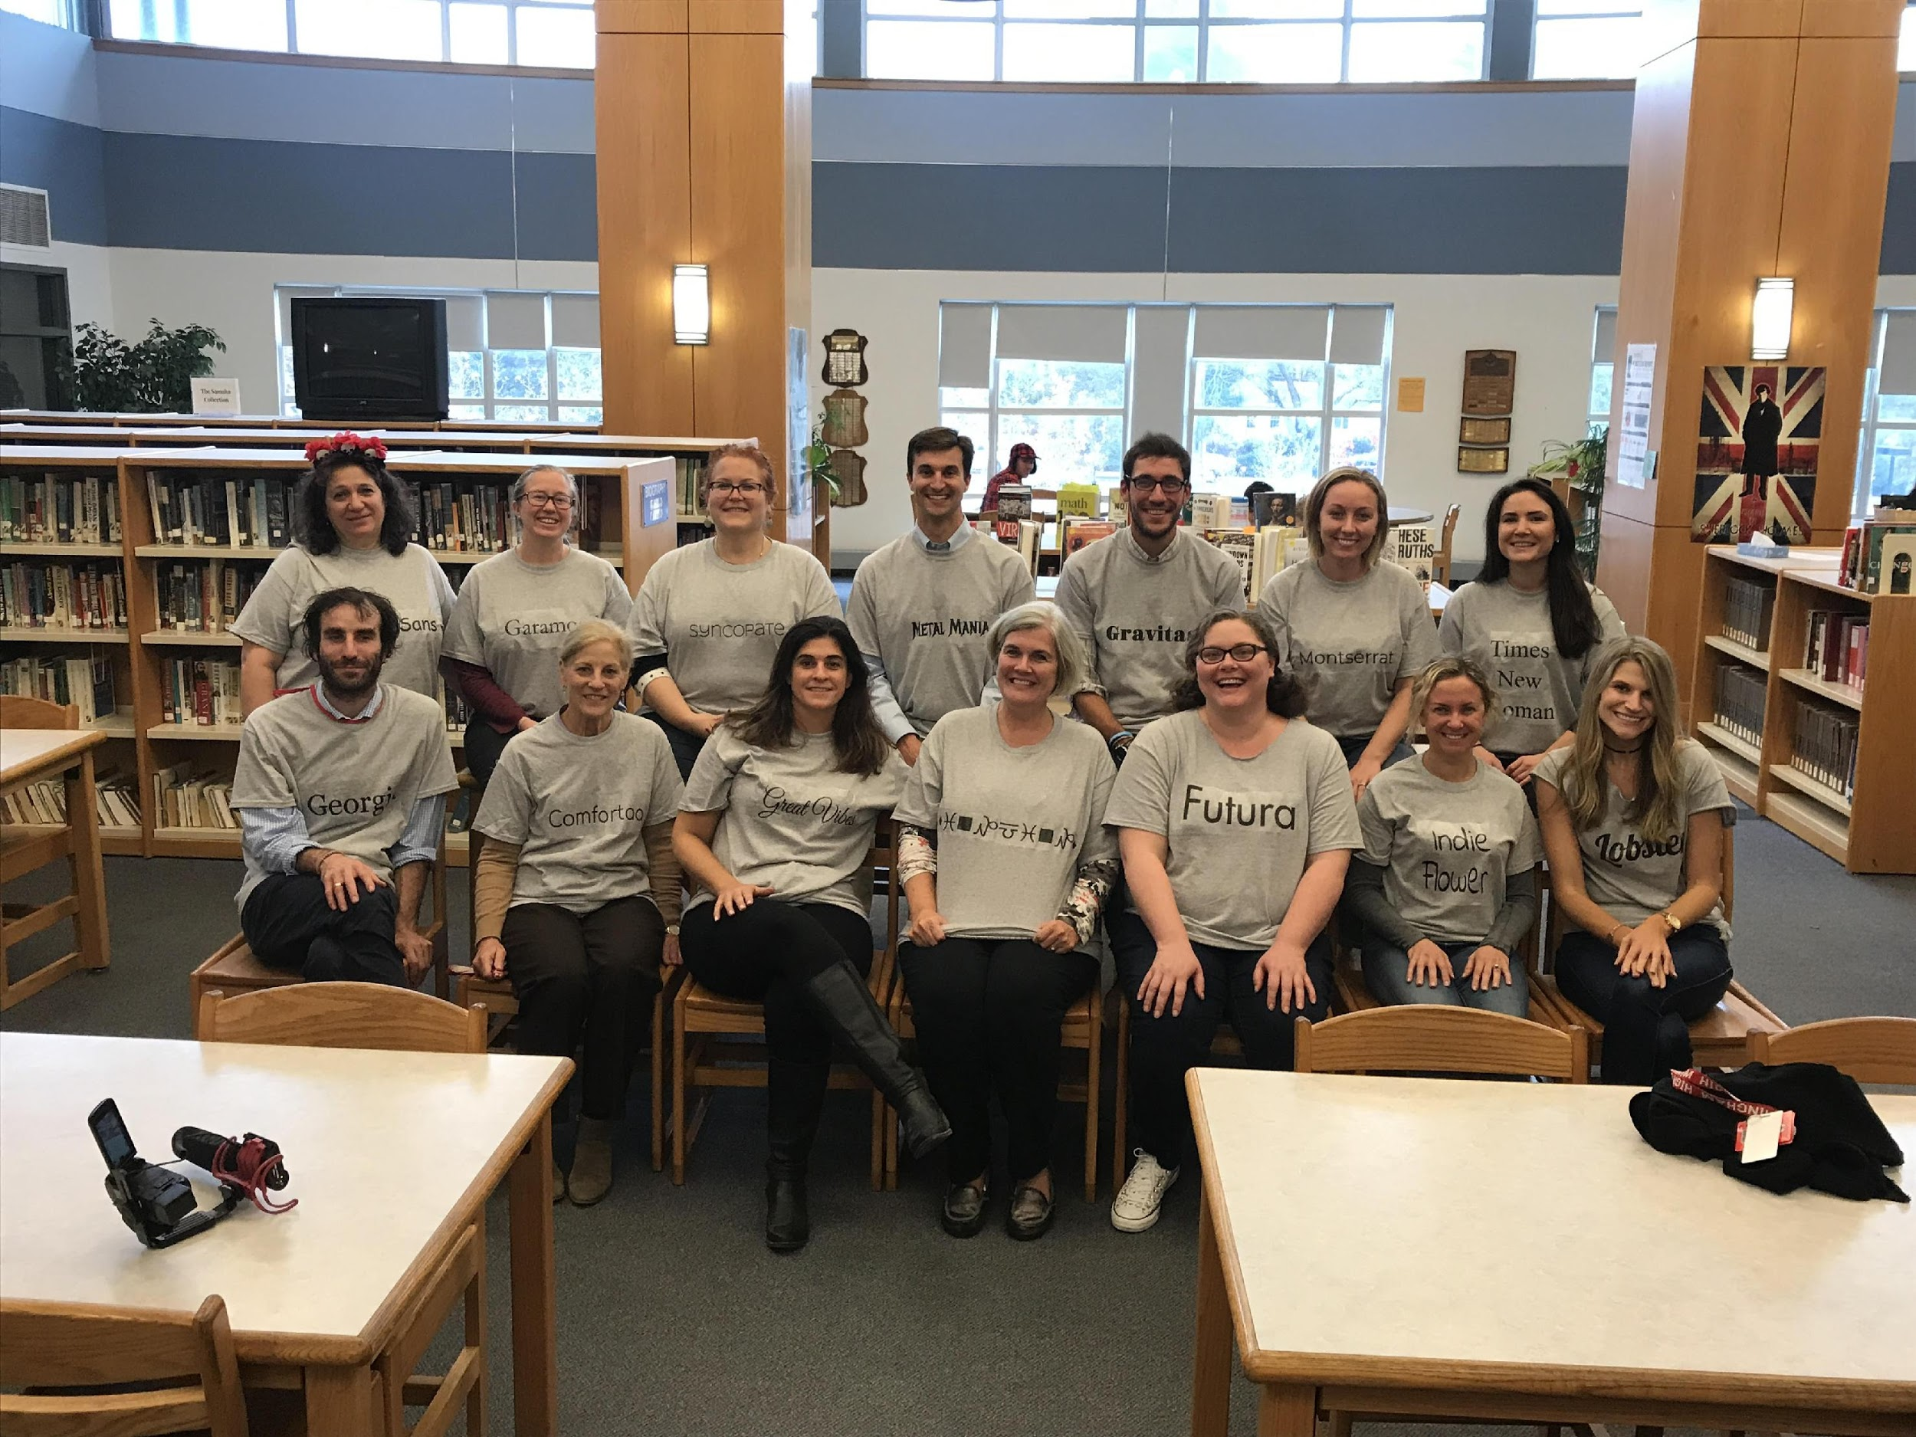
6. TEACHERS WILL ENTER COURSE RECOMMENDATIONS (WHERE APPLICABLE) ONLINE BY MARCH 10TH

Slide 10
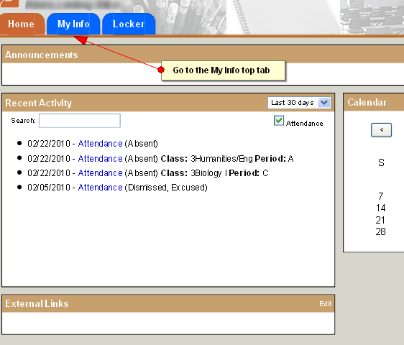
5. ALL COURSE SELECTIONS ARE COMPLETED ONLINE THROUGH THE STUDENT PORTAL
HHSPTO.WEEBLY.COM

Slide 11
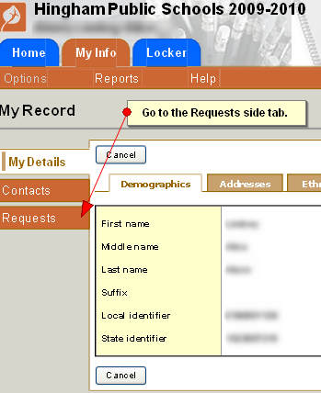
FIRST, THE “MY INFO” TOP TAB AND THEN THE “REQUESTS” SIDE TAB
HHSPTO.WEEBLY.COM

Slide 12
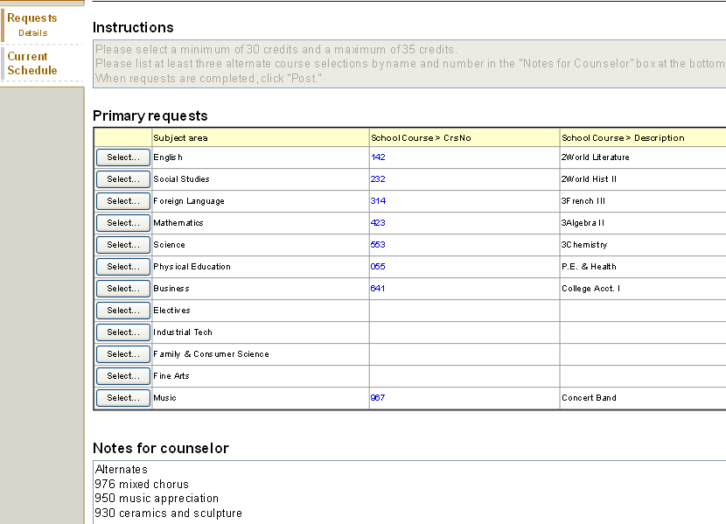
AND THEN…
HHSPTO.WEEBLY.COM

Slide 13
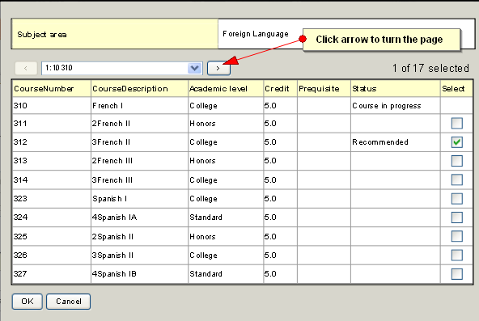
IT SHOULD BE FAIRLY INTUITIVE…
HHSPTO.WEEBLY.COM

Slide 14
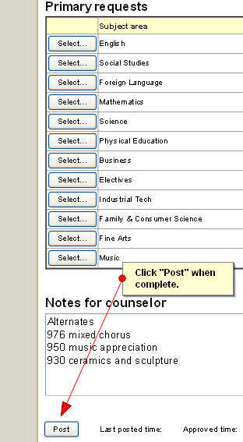
CLICK “POST” WHEN COMPLETE

Slide 15
4. THE PROCESS CONTINUES INTO APRIL
COUNSELORS MEET INDIVIDUALLY WITH STUDENTS:
3/24 @ HMS & 3/20 – 3/31 @ HHS
DRAFT OF COURSE REQUESTS SENT VIA EMAIL FOR FINAL PARENTAL REVIEW
FINAL COURSE SELECTIONS DUE TO COUNSELORS BY THURSDAY, APRIL 6TH
*PLEASE REVIEW THOSE SELECTIONS CAREFULLY*

Slide 16
HMS TIMELINE
HHS COUNSELORS PRESENT TO HMS STUDENTS ON 3/7
PARENTS & STUDENTS MAKE SELECTIONS ONLINE THROUGH ASPEN STUDENT PORTAL 3/11-3/19 (LEVEL RECOMMENDATIONS WHERE APPLICABLE WILL BE THERE)
HHS COUNSELORS MEET WITH 8TH GRADERS ON 3/24
DEADLINE FOR CHANGES: 4/6

Slide 17
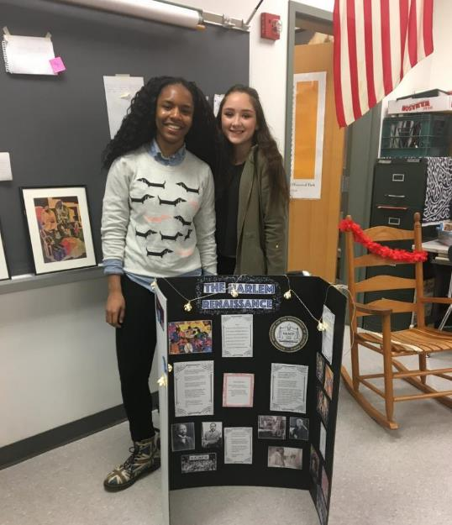
3. PAY ATTENTION TO GRADUATION REQUIREMENTS
HHSPTO.WEEBLY.COM

Slide 18
SUCH AS…
HHS GRADUATES MUST COMPLETE:
20 CREDITS IN ENGLISH
15 CREDITS IN MATH, SCIENCE & SOCIAL STUDIES
10 CREDITS IN THE SAME WORLD LANGUAGE
2.5 CREDITS IN FINE/APPLIED ARTS
2.5 CREDITS IN HEALTH
2.5 CREDITS IN PHYSICAL EDUCATION

Slide 19
A FEW DIFFERENCES BY GRADE
WITH REGARD TO PHYSICAL EDUCATION…
PLEASE NOTE DETAILS OF POLICY IN THE
PROGRAM OF STUDIES BOOKLET

Slide 20
TO EARN A DIPLOMA…
EVERYBODY MUST:
EARN 110 CREDITS (DISTRIBUTED APPROPRIATELY)
PASS THE MCAS IN ELA, MATH & SCIENCE

Slide 21
2. THE PROGRAM OF STUDIES CONTINUES TO EVOLVE

Slide 22
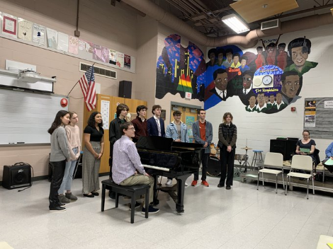
NEW COURSES IN MINDFULNESS, MUSIC AND RESEARCH!

Slide 23
SENIOR ENGLISH ELECTIVE - DISABILITY VOICES IN LIFE & LITERATURE

Slide 24
IN ADDITION TO… READING TO WRITE: AN ANALYSIS OF GENRE & STYLE

Slide 25
CONTINUATION OF OTHER RECENTLY-
PILOTED OFFERINGS SUCH AS… ENGINEERING AND ROBOTICS

Slide 26
NEW AP CLASS: AP ENVIRONMENTAL
SCIENCE

Slide 27
OTHER RECENT
AP OFFERINGS: AP COMPUTER SCIENCE AP RESEARCH AP SEMINAR

Slide 28
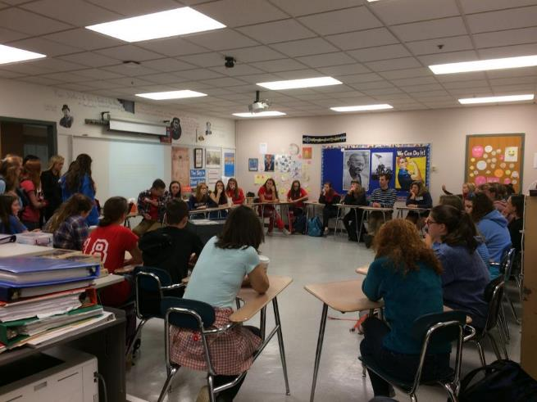
BACK BY POPULAR DEMAND: ELECTIVES LIKE HOLOCAUST & HUMAN BEHAVIOR

Slide 29
SEMINARS IN HISTORY – WORLD WAR II 20TH CENTURY POP CULTURE

Slide 30
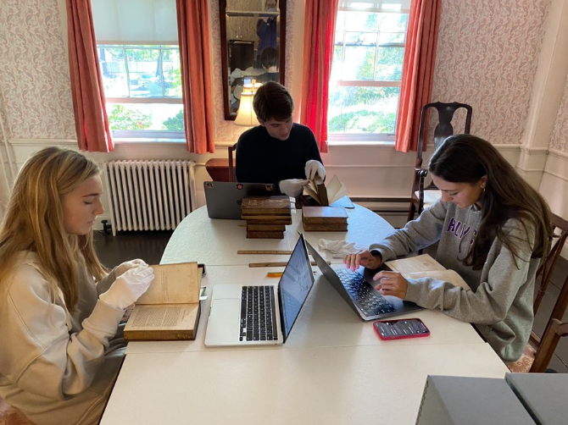
INTERNSHIP OPPORTUNITIES AT THE HINGHAM HISTORICAL SOCIETY

Slide 31
NEW SCIENCE
INTERNSHIP

Slide 32
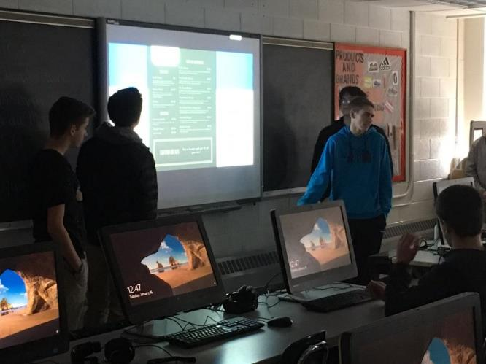
BUSINESS COURSES LIKE SPORTS MARKETING & FUNDAMENTALS OF INVESTING

Slide 33
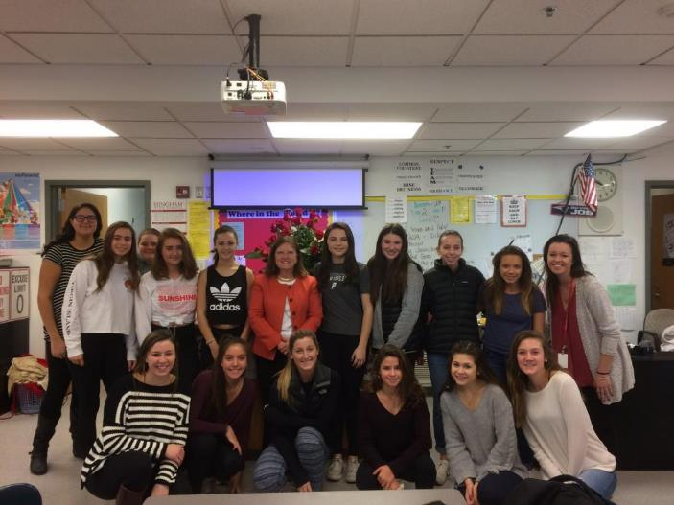
FAMILY & CONSUMER SCIENCES CONTINUE TO FLOURISH

Slide 34
AS DO THE REGULAR SCIENCES – INCLUDING ELECTRONICS

Slide 35
AND THE INDUSTRIAL ARTS

Slide 36
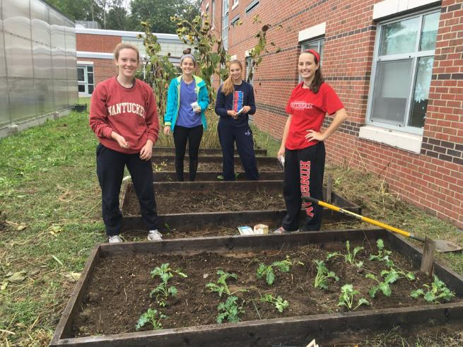
DON’T FORGET WE HAVE A GREENHOUSE (AND A BOTANY COURSE)!

Slide 37
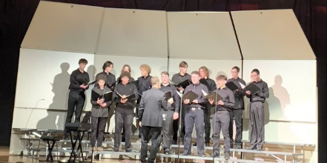
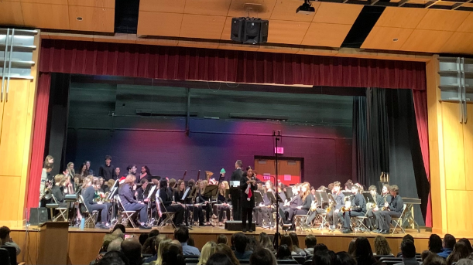
OUR MUSIC PROGRAM CONTINUES TO FLOURISH

Slide 38
SO MANY GREAT CHOICES
PLEASE CONSIDER THEM CAREFULLY!
THE SCHEDULE IS BUILT – AND TEACHERS ARE ASSIGNED – BASED ON SPRING COURSE REQUESTS.
HHS MAY NOT BE ABLE TO ACCOMMODATE REQUESTS FOR CHANGES AFTER THE SPRING DEADLINE.

Slide 39
1. PLEASE VISIT THE WEBSITE REGULARLY
hinghamschools.org/
hingham-high-school/

Slide 40
AND LOOK FOR DAILY HHS UPDATES ON TWITTER
@RSWANSONHINGHAM

Slide 41
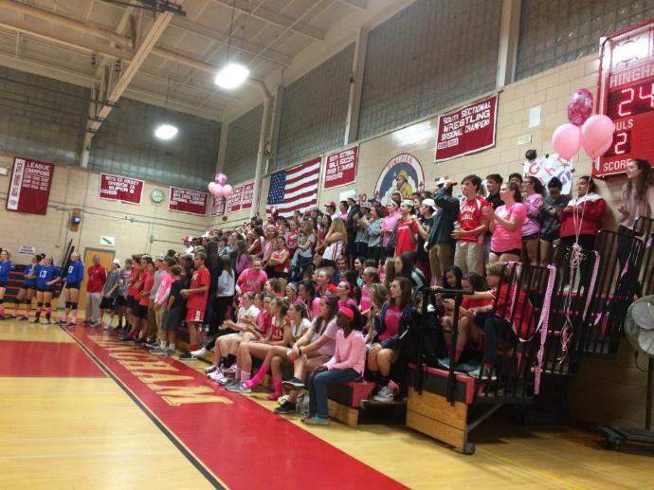
ONWARD
AND
UPWARD IN 2023

Slide 42
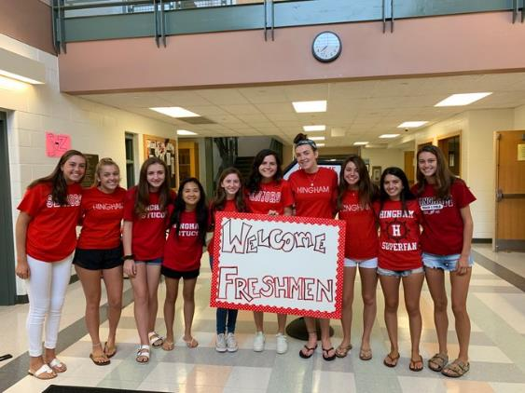
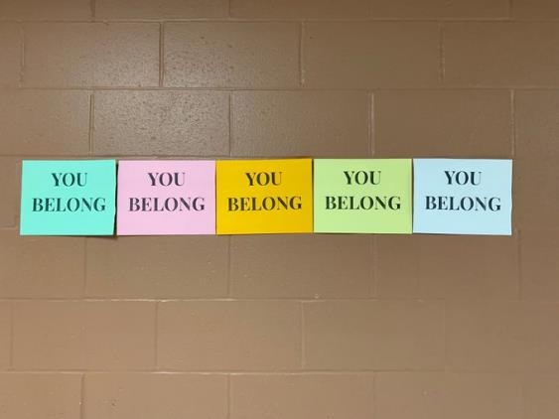
THIS IS YOUR SCHOOL

Slide 43
STAY UP TO DATE!
IF YOU DON’T ALREADY GET THE WEEKLY UPDATE,
PLEASE SIGN UP:
HINGHAMHIGHPTO@GMAIL.COM

Slide 44
DEPARTMENT DIRECTORS & COUNSELORS CAN ASSIST WITH FOLLOW-UP QUESTIONS

